Slide 1
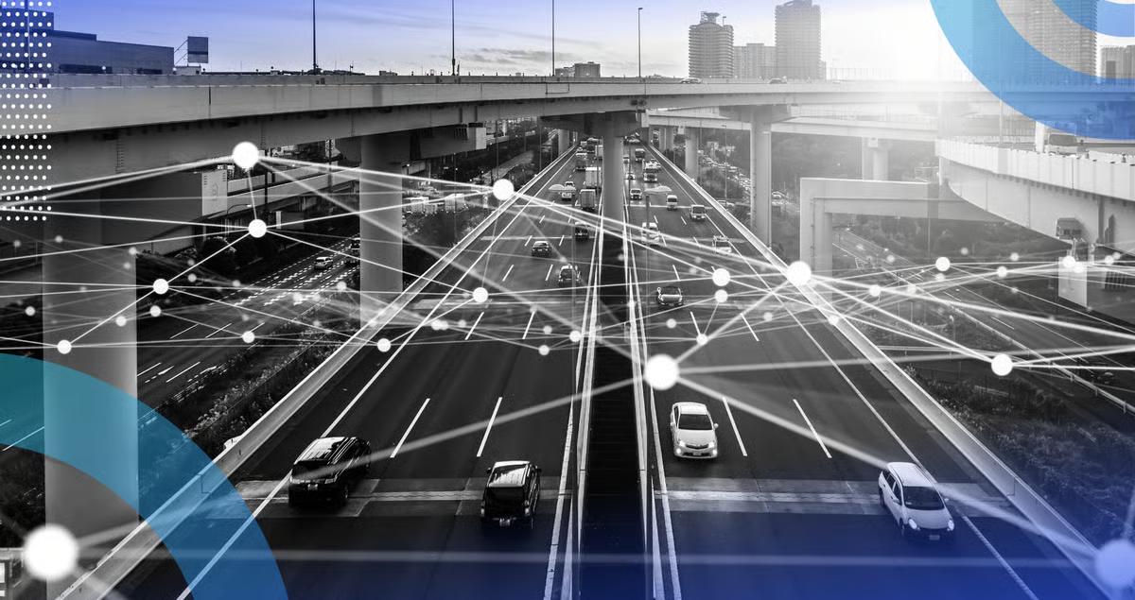

Computer vision applications using artificial intelligence

Slide 2


Who am I?
Current Position:
Lecturer, Facility of Engineering and Technology Botho University
Professional Experience:
Consulting Software Engineer, Orange Botswana
Freelance Machine Learning Engineer (2019 - 2023)
Education:
Master of Engineering in Computer Science and Technology, Xi'an Jiaotong University
Bachelor of Science (Honors) in Network Security and Computer Forensics, Botho University
Areas of Expertise:
DevOps Engineering
Machine Learning & AI
Computer Vision
Data Science
Cybercrime Investigation
www.bothouniversity.com
Notes:
Hello everyone, I’m Koorapetse Lesotlho. I’m thrilled to be here today to share my journey as a DevOps Engineer and Machine Learning & AI specialist. My path has taken me from the vibrant classrooms of Botho University, where I now lecture, to the innovative corridors of Orange Botswana, and even into the world of freelancing as a machine learning engineer. My academic journey began with a Bachelor’s degree in Network Security from Botho University, where I developed a fascination for the intersection of technology and security. I then pursued a Master’s of Engineering in Computer Science and Technology at Xi'an Jiaotong University, diving deep into the realms of computer vision and data science. What drives me is the power of technology to transform lives and industries. I believe we stand at the precipice of an era where AI and machine learning can solve some of our most pressing challenges. My mission is to inspire the next generation of innovators to harness these tools responsibly and creatively. Today, I invite you to explore with me the incredible possibilities that lie ahead in the world of technology. Together, we can shape a future where our innovations serve humanity and drive positive change.

Slide 3
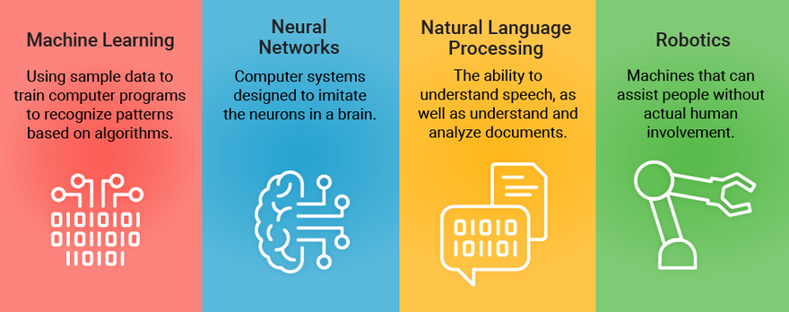
What is artificial intelligence?
www.bothouniversity.com
Notes:
What is artificial intelligence?
Once a staple of science fiction -- think, Frankenstein -- artificial intelligence, or AI, is commonly used by billions of people. Although there’s no set definition, it’s generally agreed that artificial intelligence is the use of computers to mimic human judgment. These days, it’s used by almost every industry, often in ways that are too subtle to be noticed.
Categories of artificial intelligence
There are three basic categories of artificial intelligence:
Narrow AI: Artificial intelligence can be built for very specific tasks, such as playing a game, keeping spam out of your inbox, helping you find a nearby restaurant with your smartphone, or even driving your car.
General AI: With more resemblance to human capabilities, general artificial intelligence is a more advanced form that can involve visual and language processing, contextual understanding, and the ability to adapt to a range of tasks. It’s considered to be far off in the future.
Artificial super AI: Imagine a machine that’s smarter than you -- much smarter. Artificial superintelligence is still only a theory, but advances in nascent AI are raising interesting and troubling questions for the future of humanity.

Slide 4
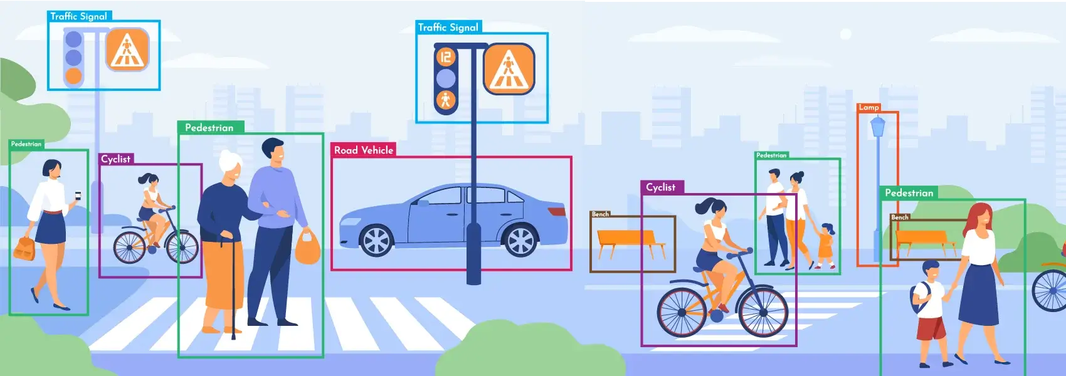
What is Computer Vision?
Computer vision is a deep learning application that lies at the heart of this revolution. It allows computers to derive insight from visual input such as images and video files. Examples of computer vision include face detection, facial recognition, human pose estimation, and obstacle detection. In this lecture, we will explore how to perform face detection and recognition.
www.bothouniversity.com
Notes:
We are currently living in an age of AI revolution, marked by impressive advancements in the field of deep learning. In just the past few months,
we’ve witnessed applications of artificial intelligence that stunned the world by generating realistic pieces of artwork, passing the bar exam,
and writing Python code to create websites.
Computer vision is a field of artificial intelligence (AI) that applies machine learning to images and videos to understand media and make decisions about them. With computer vision, we can, in a sense, give vision to software and technology.

Slide 5
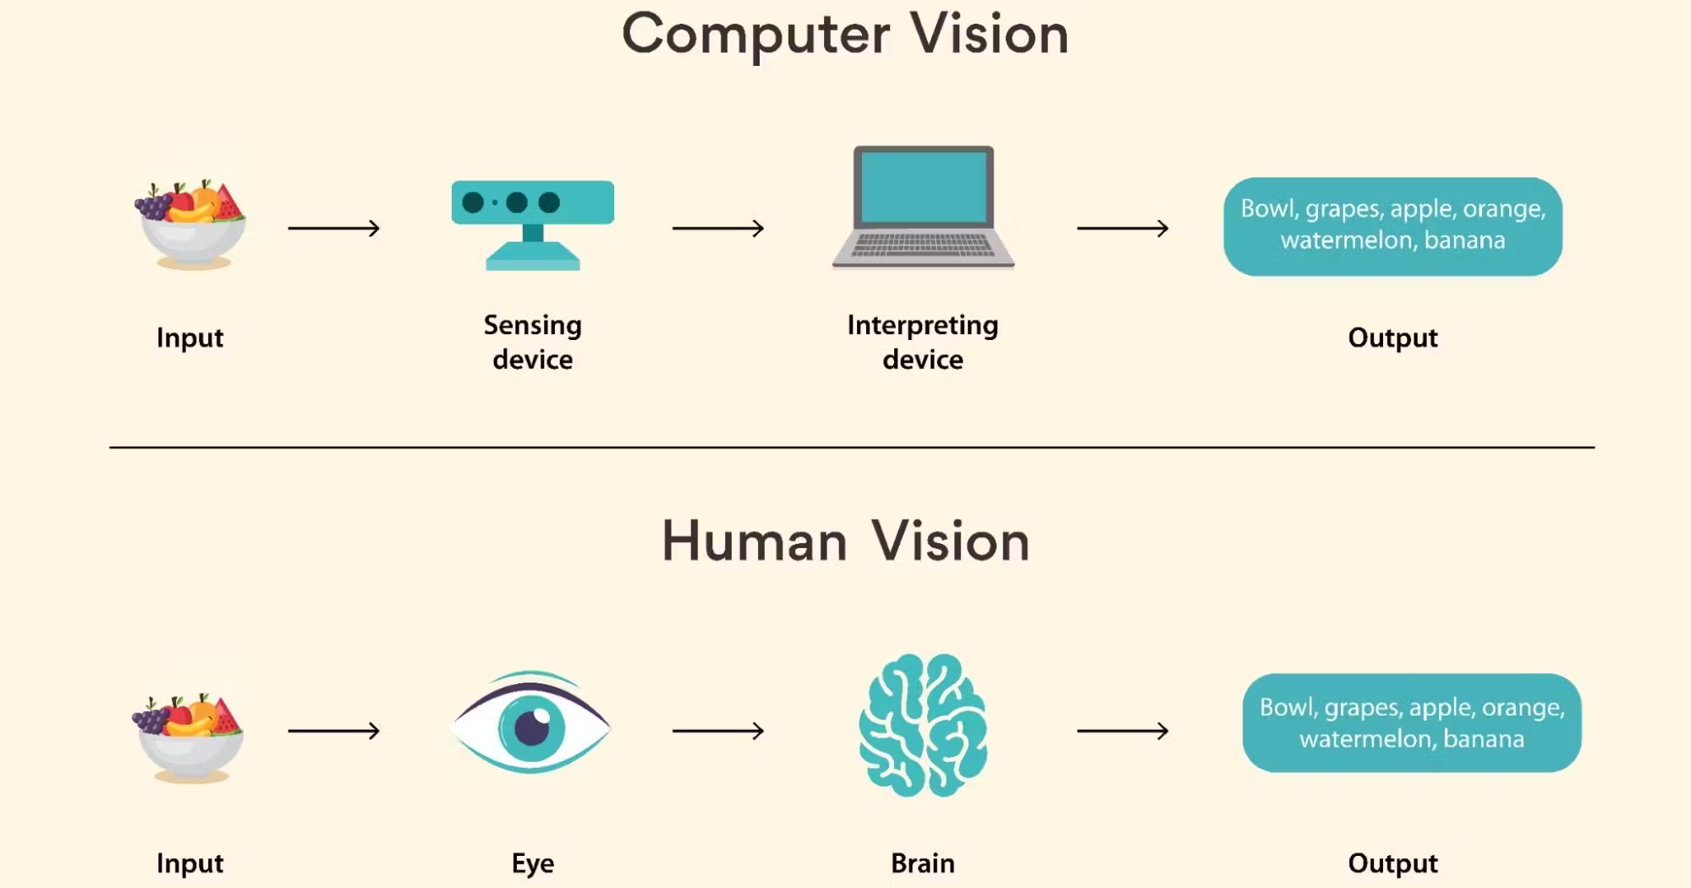
How Does Computer Vision work?
www.bothouniversity.com
Notes:
This question is like asking how the human brain works. The field of neuroscience has forever been intrigued by how complex our brains are and how they work. Machine learning asks the same question and works in the answer to develop this field of computer science. Now we all know that brains aren’t easy to study and even science doesn’t have all the answers yet on the exact way images are processed in the brain. This is why computer vision works on what we do know: recognizing patterns. So how does the computer learn to recognize an image? It all gets down to understanding the complexity of pixels and colors. In simple words, if you feed an algorithm with millions of images of a book, a set of machine learning algorithms will help it analyze the colors, shapes and the relative distance between objects. This helps the computer understand what a “book” is based on the types of data sets. Once done, this computer will be able to recognize books from images that are fed into it in the future. Let’s break it down into steps. Here’s what a computer does:
Acquire an image
Process the image
Understand the image

Slide 6

How Does Computer Vision work?
The Built In favicon (left) shown in grayscale and (right) the same image with the pixel values overlaid.
www.bothouniversity.com
Notes:
The basis for much computer vision work is 2D images, as shown below. While images may seem like a complex input, we can decompose them into raw numbers. Images are really just a combination of individual pixels and each pixel can
be represented by a number (grayscale) or combination of numbers such as (255, 0, 0—RGB). The basis for much computer vision work is 2D images, as shown below. While images may seem like a complex input, we can decompose them
into raw numbers. Images are really just a combination of individual pixels and each pixel can be represented by a number (grayscale) or combination of numbers such as (255, 0, 0—RGB).

Slide 7
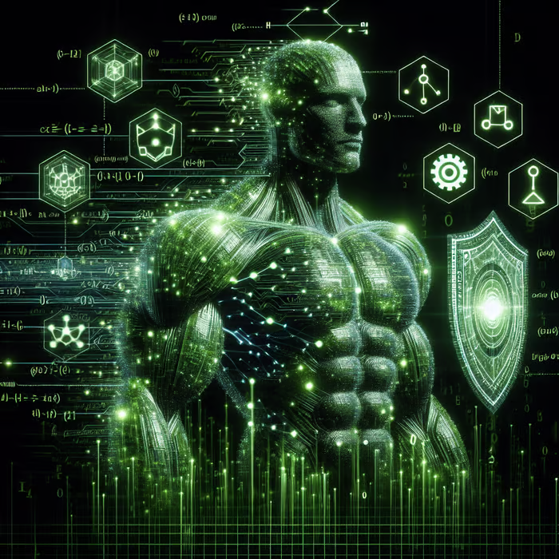
Advantages of Computer Vision
Better Searching Methods:
Visual search for products (e.g., image-based searches in advertising).
Enhanced User Experience:
Filters on apps (e.g., Snapchat, Instagram).
Healthcare Advancements:
Patient identification & accurate diagnoses.
Rehabilitation & medical student training.
Improved Security:
Biometrics, surveillance, vehicle ID, AI fire detection.
Transport Safety:
Detects dangerous objects in public transport.
www.bothouniversity.com
Notes:
Better Searching Methods: Let’s talk about the advertising industry. Digital advertising mainly relied on keywords and tags. While the method works it’s not cent percent efficient. After the introduction of computer vision to this sector, results got a lot better.Instead of relying on traditional tags, computer vision compares the actual physical characteristics of a specific image. Because of this, people are able to search for exactly what they’re looking for by using a photo to find “similar products”.
Better User Experience: Those filters that transform your face on Snapchat and Instagram are a result of computer vision! With the use of facial mapping and augmentation, computer vision makes it possible to create such features on apps.
Patient Identification And Better Medical Procedures :Computer vision improves patient identification thereby preventing wrong person procedures. One can also expect a more accurate diagnosis via medical imaging analysis. From surgery training assistance to patient rehabilitation assistance, computer vision helps the medical field to achieve goals that were once far-fetched. The contribution of computer vision to the medical field is quite a boon. Here are some examples of how it helps:
• Patient rehabilitation assistance.
• Medical students training.
• Patient identification.
Better Security
Computer vision works with cyber security systems to monitor any remote activity. This can be done from anywhere which makes it easier to recognize and analyze potential cyber threats and prevent them from happening.
Here are some ways in which computer vision is used: • Biometrics for identification. • Security cameras. • Vehicle identification in instances of car theft. • AI fire detection that helps detect fires in buildings by taking images or videos.
Transport Safety
Computer vision is trained and used to identify unauthorized and harmful objects such as guns, biological weapons, etc, before they are loaded on passenger transport vehicles like an aircraft.

Slide 8
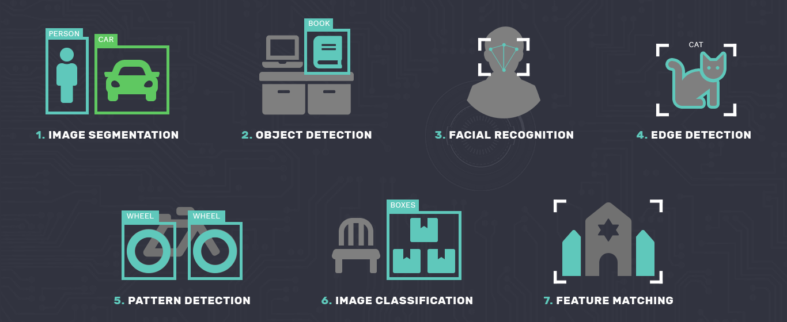
Types of Computer Vision
www.bothouniversity.com
Notes:
Image segmentation: Here, the image is divided into multiple regions that are examined separately.
Object detection: This pertains to identification of a specific object in one image. For instance, a book like we talked about earlier. With advanced object detection, your computer can recognize multiple objects in one image.
Facial recognition: Whether it’s human face recognition in general like in those app filters or recognition of a specific person like in a smartphone for unlocking, computer vision does it all.
Edge detection: This method identifies the outer edges of objects to identify what the image consists of.
Pattern detection: This technique helps with identification of colors, shapes, and other visual elements in images.
Image classification: Organizing images into various groups and categories.
Feature matching: This method helps match similarities in images to classify them.
While simple uses of computer vision might just require one of these techniques, more complex ones like self-driving cars may make the use of a combination of various types of computer vision.

Slide 9
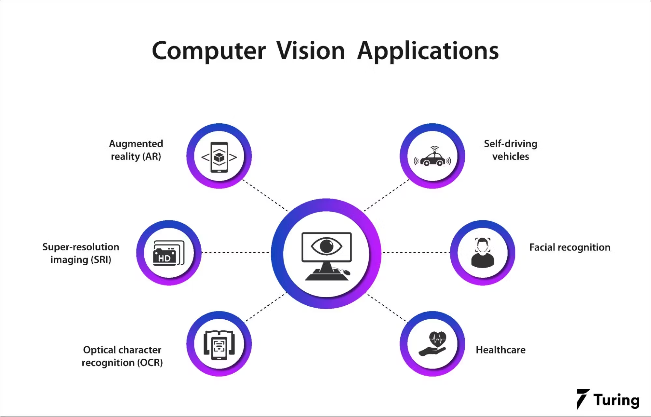
Applications of Computer Vision
www.bothouniversity.com
Notes:
Self-driving cars Since dreams of self-driving cars are coming true, a lot of is can be attributed to computer vision. Tesla has already come up with autonomous vehicles and it’s just a matter of time before you can get around your city in a driverless car too!
Augmented Reality Augmented reality uses computer-generated augmentation to provide an experience of the natural surroundings. If you’ve played games that use AR, you know that they can make you feel like you’re actually in that virtual world while your actions here in the real world affect what’s going on inside the game! You swing your golf club here and the ball goes flying in the game. How cool is that?
Medical Imaging How does a doctor classify X-rays and MRIs into diseases like cancer and pneumonia? Computer vision is the core of early diagnosis in the medical field. It has helped save thousands of lives by enabling doctors to detect diseases early with the help of imaging.
Intelligent Video Analytics Identification techniques like pose estimation, face detection and object tracking have helped CCTV cameras in understanding a shopper’s interaction with various products in a retail shop, queue lengths at airports and malls and other such parameters in public places with large crowds.
Manufacturing and Construction Computer vision systems help in detection of defects and with safety inspections. This helps in a better manufacturing process with fewer chances of error. 3D vision systems make inspections far more superior and efficient in production lines.
Optical Character Recognition OCR goes back to 1974 but with the latest technology and Deep Learning systems, today’s OCR techniques can detect and translate text in natural environments without any human intervention.
Read more: OCR in Machine Learning
Retail Nowadays there are AI stores like “Amazon-go” across the United States that are cashierless and customers can self-checkout after shopping. This shows that computer vision can revolutionize shopping experiences for both the store owners and the consumers.
Education There’s nothing better than providing a personalized learning experience to students because one size doesn’t fit all. Computer vision understands students’ learning behaviors to improve their learning experiences. The technology also helps assess students’ papers to reduce the burden on teachers.
Sports and Fitness Computer vision can help fitness apps capture performance data. This can not only help the person using the app but also help coaches in training sessions. In sports, computer vision can track objects and ball movements to improve referees’ decision-making.

Slide 10
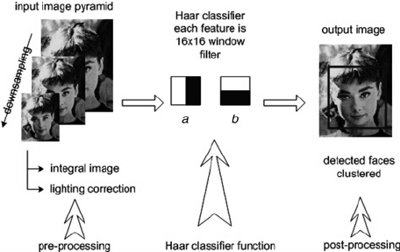
Introduction to Haar Cascade Classifiers
www.bothouniversity.com
Notes:
The idea behind this technique involves using a cascade of classifiers to detect different features in an image. These classifiers are then combined into one strong classifier that can accurately distinguish between samples that contain a human face from those that don’t.
The Haar Cascade classifier that is built into OpenCV has already been trained on a large dataset of human faces, so no further training is required. We just need to load the classifier from the library and use it to perform face detection on an input image.

Slide 11
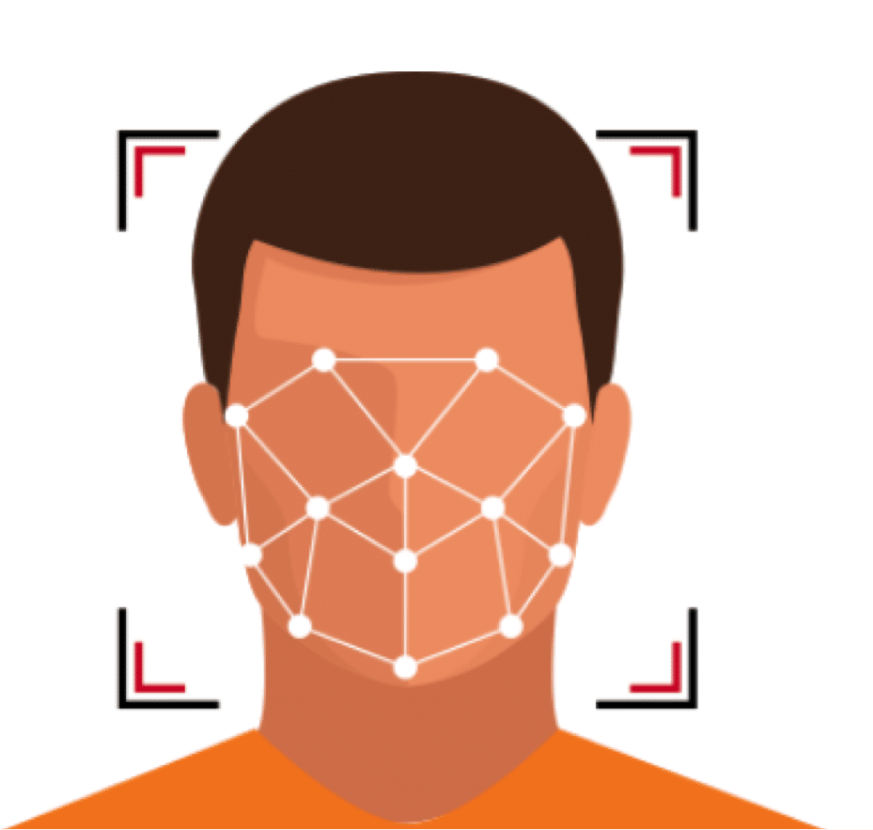
What is Face Detection?
What is Face Detection?
Process of identifying a person’s face in an image or video.
Analyzes visual input to detect facial features.
Challenges in Face Detection:
Faces are diverse across backgrounds, genders, and cultures.
Requires large datasets for accurate training.
Needs multiple examples with varied lighting, angles, and orientations.
Time and Data Intensive:
Model training requires millions of data samples.
Time-consuming due to the complexities of real-world scenarios.
Solution: Pre-trained Models with OpenCV
OpenCV provides pre-trained face detection models.
Uses Haar cascade machine learning technique to detect objects in visual data.
www.bothouniversity.com

Slide 12
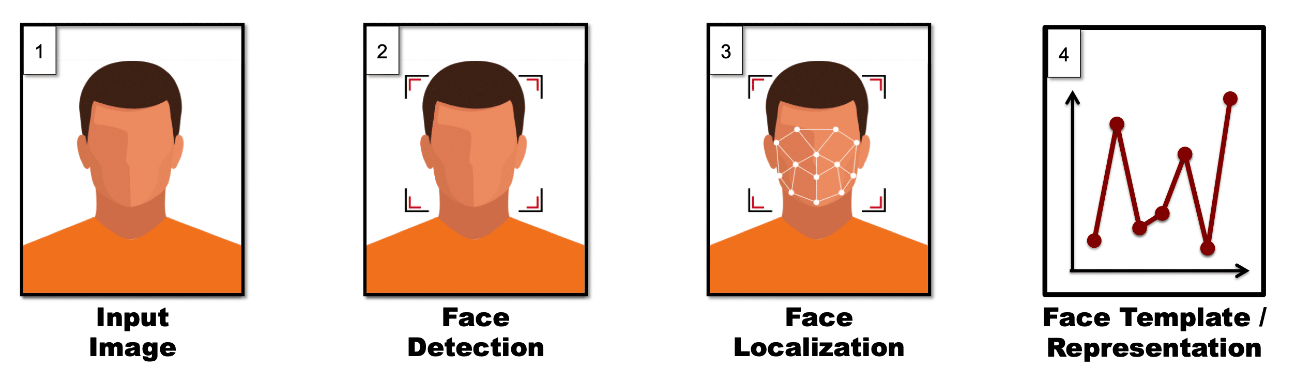
Face Recognition
www.bothouniversity.com
Notes:
The representation step is used to process all incoming imagery. This could be from the initial ingestion of a reference database of images (e.g., employee ID card images), or during a live presentation of a face to the system (e.g., an employee presents themself to a camera for facility access). The output of the representation step is a facial template that contains the encoded facial features.
The steps performed during representation, to go from an input image to encoded facial features, are as follows:
The first step in automated face recognition is to detect all faces present in an image. In some cases the application may dictate that there will only be one face in an image (e.g., capturing ID card photo), but unless the integrator provides this information to the algorithm, the algorithm cannot make any such assumptions. Instead, it will attempt to detect all faces present in an image (or video frame).
Let’s consider the following image as an example:

Slide 13
Live Demo Session
www.bothouniversity.com

Slide 14


THANK YOU

